Slide 1

RFID Attend Track
Created By:
Om Bhamare
Aditya Bhalerao
Dhawal Chorwadkar

Slide 2

INDEX
RFID
Description
Working
Application
RFID vs Barcode
RFID Attendance Tracking
Block Diagram
Circuit Diagram
Working

Slide 3
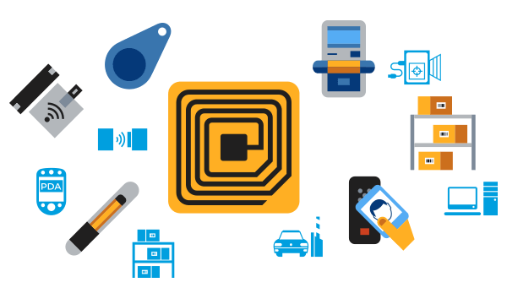
RFID
RFID is a acronym of Radio Frequency Identification.
RFID is a member of AIDC or Automatic Identification Data Capture Technology
RFID tags are powered by internal battery and are typically read/write and it’s memory size varies according to requirements.
It was first used in world war 2.
In 2014 RFID market was US $8,89 billion its market is increasing as in 2020 it was US $12.08 billion and its is estimated to be US $16.23 billion till 2029.

Slide 4
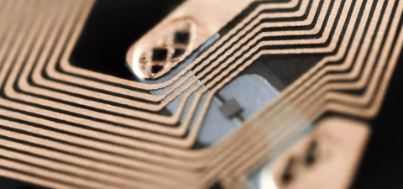
Working Of RFID
It contains three parts:
RFID Reader
RFID Antenna
RFID Tags
Its lowest Frequency Range is up to 125 - 134kHz and read range between 0 to 10cm.
Its High Frequency Range is up to 13.56MHz and read range is about 30cm.
Its ultra high frequency range is of 860 – 960Mhz.

Slide 5
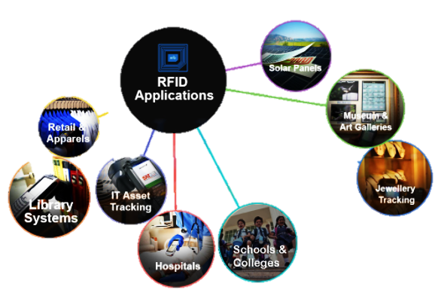
RFID Application

Slide 6
Types Of RFID
Active
Passive
Continuously transmit the signal
Each signal range up to 150 meter
Ex: Vehicle tolling or Real time tracking
Has Longer life but no internal power source
Lower Signal Range
Ex: Packages

Slide 7
RFID vs Barcode
Both allow you to track object and both can store readable data by scanning.
Difference are:
Barcodes can be scanned one ta a time ,where as RFID can be scanned at once using multiple tags.
Barcodes stores limited data where as RFID allows for 2000 bytes of data in single tag.
Barcode requires scanner to have direct LOS but RFID is near-field technology.
RFID speed is to fast and also more accurate then RFID.

Slide 8
Block Diagram Of Project
RFID Scanner
Arduino
PLX-DAQ (Excel)
RFID Cards
Buzzer
Power Supply

Slide 9
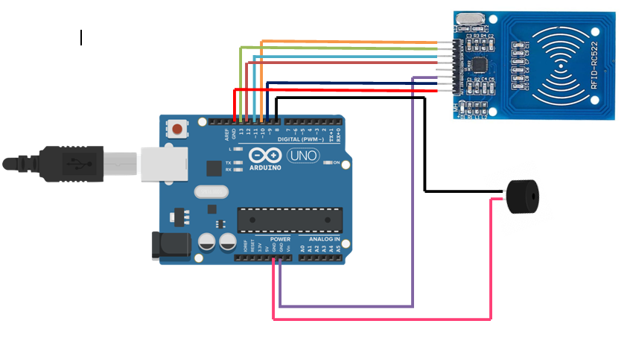
Circuit Diagram Of Project

Slide 10
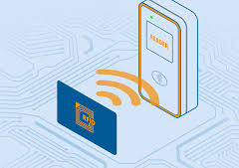
Flowchart
Start
Give Power
Scan RFID Card
Scanned
YES
NO
Result stored in PLX-DAQ
No Result Stored
END

Slide 11
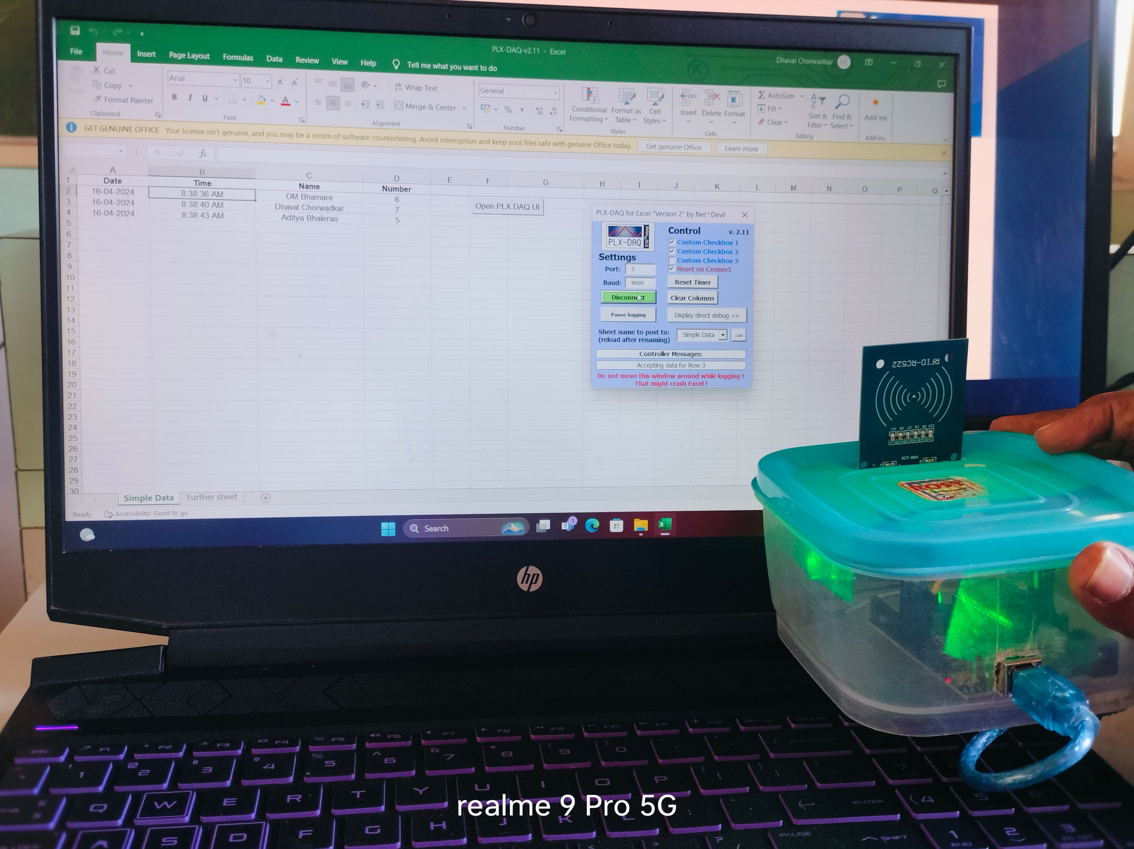
Working

Slide 12
Conclusion
Lecture need no more wasting time, and effort to have their Attendance Register.
Attendance now easily uploaded to database.
As Attendance will be uploaded through RFID card student will never forget their Id-card.
It is next step towards digital India.

Slide 13


